Slide 1
CHAPTER 4
LISTS
All the programs in this file are selected from
Ellis Horowitz, Sartaj Sahni, and Susan Anderson-Freed
“Fundamentals of Data Structures in C”,
CHAPTER 2

Slide 2
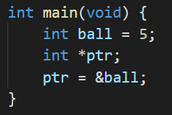
Pointer
做法說明:
 | 值 | 記憶體位址
ball
5
0061FF18
ptr
0061FF18
0061FF1C
CHAPTER 2

Slide 3
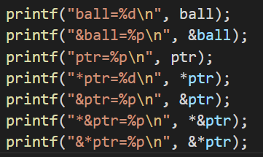
Pointer
 | 值 | 記憶體位址
ball
5
0061FF18
ptr
0061FF18
0061FF1C
做法說明:
5
0061FF18
0061FF18
0061FF1C
5
0061FF18
0061FF18
結論: *&ptr = &*ptr = ptr
CHAPTER 2

Slide 4

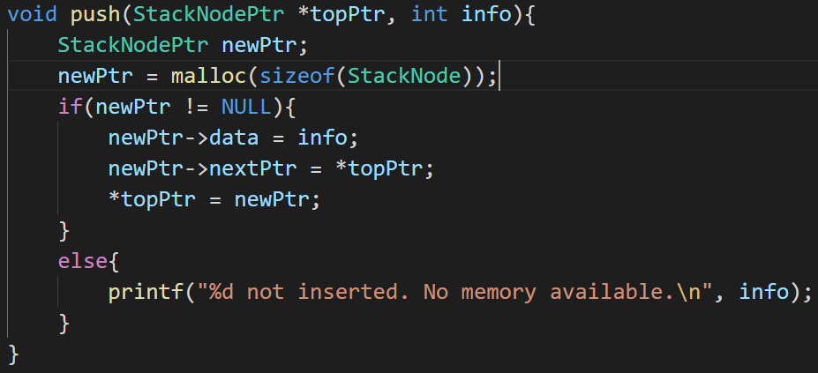
Pointer
把&stackPtr帶入
topPtr = &stackPtr
* topPtr = *&stackPtr
根據前頁結論
*&stackPtr = stackPtr
push(), pop(), enqueue(), dequeue()同理
做法說明:
CHAPTER 2

